Slide 1
FDI analysis
File created on: 2/26/2024 10:11:30 PM

Slide 2
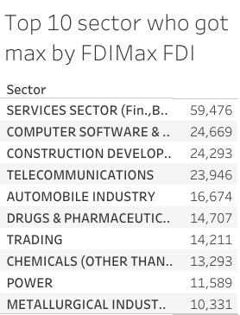

Slide 3
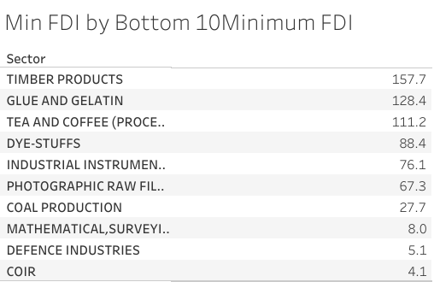

Slide 4
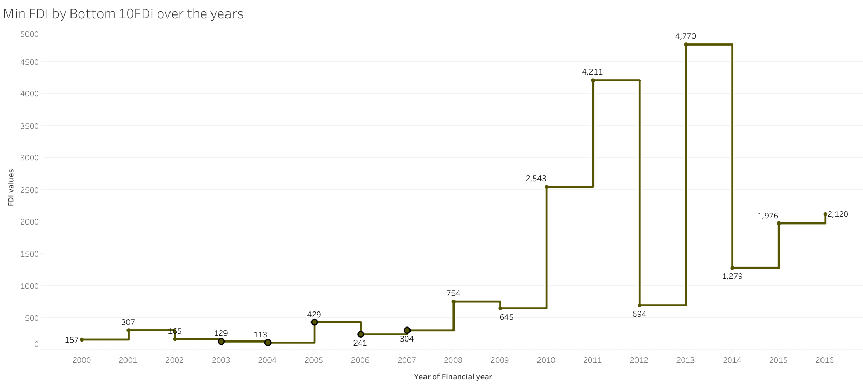

Slide 5
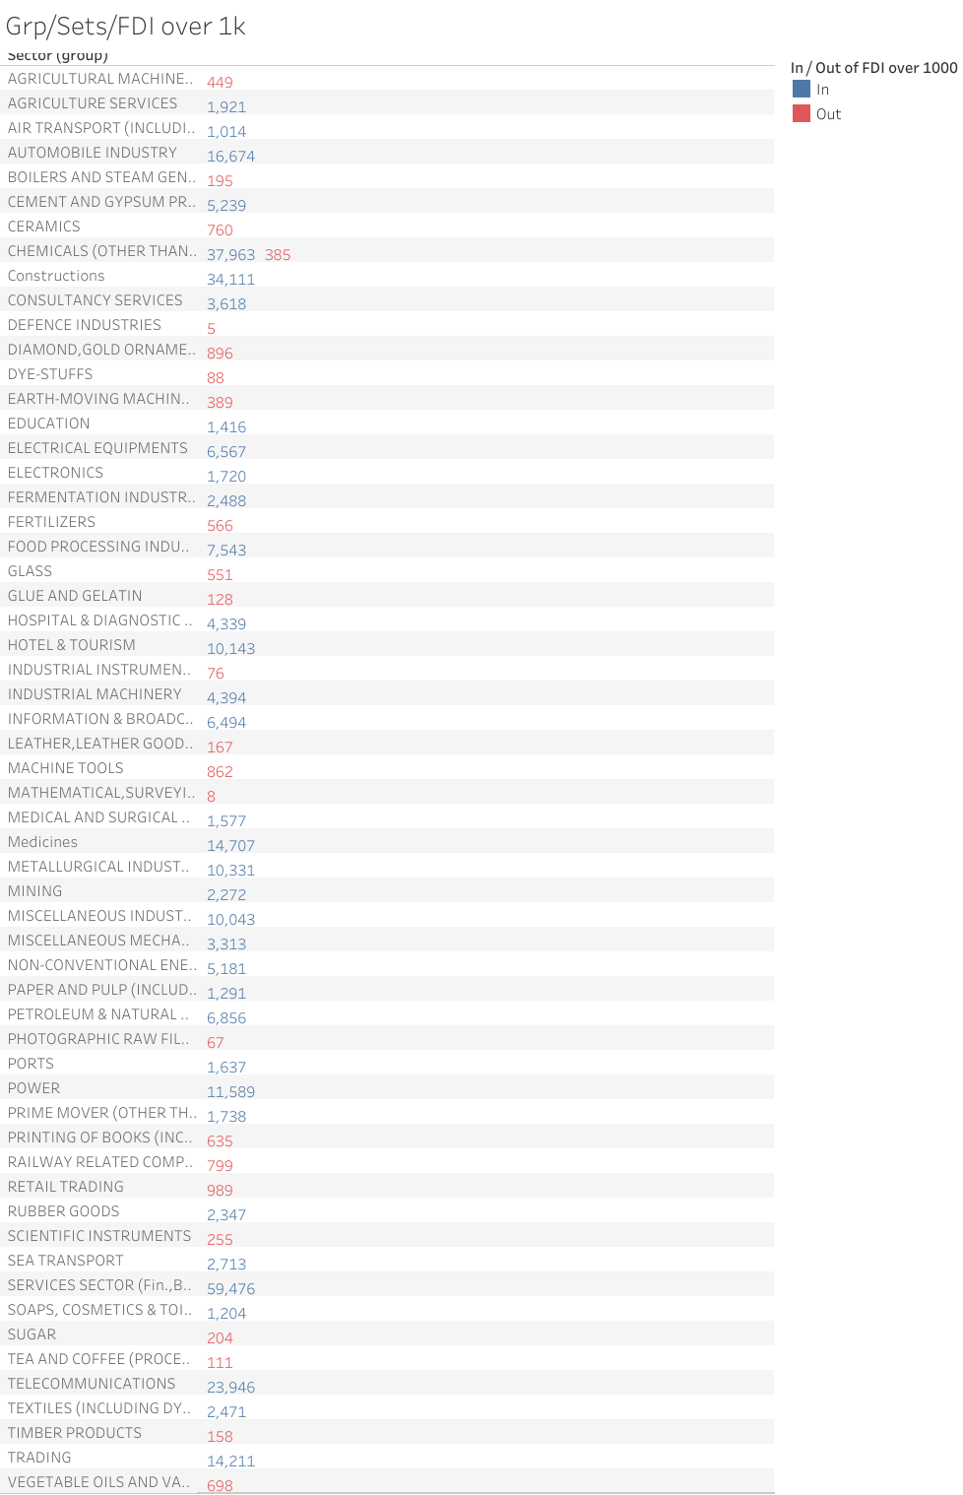

Slide 6
